Slide 1
1.3 The Units of Measurement
Units - the basic quantity of mass, volume or whatever quantity is being measured
  A measurement is useless without its units
8
English system - a collection of functionally unrelated units
  Difficult to convert from one unit to another
    1 foot = 12 inches = 0.33 yard = 1/5280 miles
Metric System - composed of a set of units that are related to each other decimally, systematic
  Units relate by powers of tens

Slide 2
Metric System Units
8
Mass - the quantity of matter in an object
  not synonymous with weight
    Weight = mass x acceleration due to gravity
  standard unit is the gram (g)
  The pound (lb) is the common English unit
  1 lb = 454 g
Mass must be measured on a balance (not a scale)
1.3 The Units of Measurement

Slide 3
Metric System Units - continued
Length - the distance between two points
  standard unit is the meter (m)
  The yard is the common English unit
  1 yd = 0.914 m
Volume - the space occupied by an object
  standard unit is the liter (L)
  The quart is the common English unit
  1 qt = 0.946 L
  Time
    The metric unit is the second (s)
1.3 The Units of Measurement

Slide 4
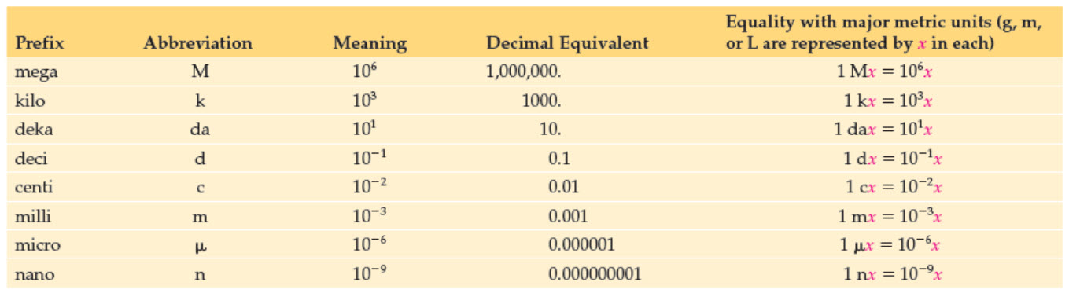
Metric System Prefixes
Basic units are the units of a quantity without any metric prefix
Copyright © 2017 McGraw-Hill Education. Permission required for reproduction or display

Slide 5
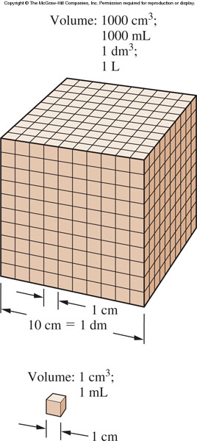
Relationship among various volume units
  Volume =
  Length x width x height
1.3 The Units of Measurement
  Volume =
  1 m x 1 m x 1 m =
  1 m³
  1 m³ = 1 L

Slide 6
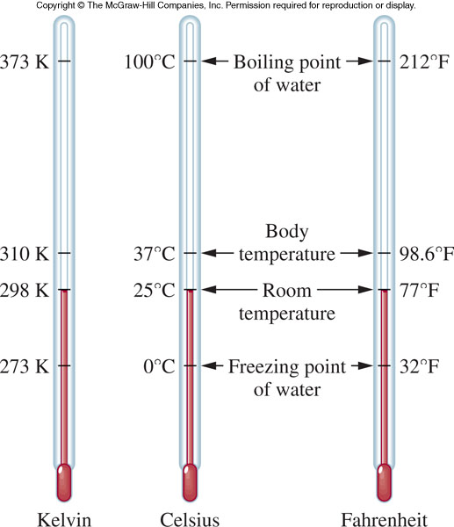
1.6 Additional Experimental Quantities
Temperature - the degree of “hotness” of an object

Slide 7
Kelvin Temperature Scale
The Kelvin (K) scale is another temperature scale
It is of particular importance because it is directly related to molecular motion
As molecular speed increases, the Kelvin temperature proportionately increases
1.6 Additional Experimental Quantities
T
=
T
+ 273.15
K
ºC

Slide 8
Energy
Energy - the ability to do work
  kinetic energy - the energy of motion (energy of action)
  potential energy - the energy of position (stored energy)
Energy is also categorized by form:
  light
  heat
  electrical
  mechanical
  chemical
1.6 Additional Experimental Quantities

Slide 9
Characteristics of Energy
  Energy cannot be created or destroyed
  Energy may be converted from one form to another
  Energy conversion always occurs with less than 100% efficiency
  All chemical reactions involve either a “gain” or “loss” of energy
1.6 Additional Experimental Quantities

Slide 10
Units of Energy
Basic Units:
  calorie or joule
  1 calorie (cal) = 4.18 joules (J)
kilocalorie (kcal) = food Calorie
1 kcal = 1 Calorie = 1000 calories
1 calorie = amount of heat energy required to increase the temperature of 1 gram of water 1ºC
1.6 Additional Experimental Quantities

Slide 11
Concentration
Concentration:
  the number or mass of particles of a substance contained in a specified volume
Often used to represent the mixtures of different substances
  Concentration of oxygen in the air
  Pollen counts
  Proper dose of an antibiotic
1.6 Additional Experimental Quantities

Slide 12
Density and Specific Gravity
Density
  the ratio of mass to volume
  an extensive property
  use to characterize a substance as each substance has a unique density
  Units for density include:
    g/mL
    g/cm³
    g/cc
13
1.6 Additional Experimental Quantities

Slide 13
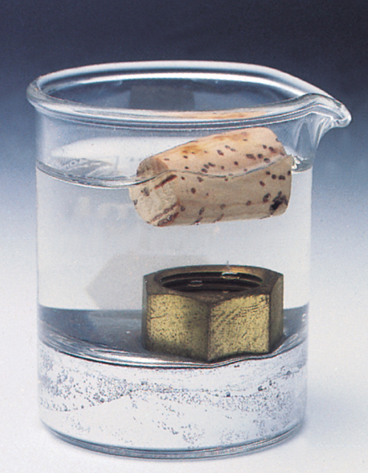
Density
Examples
cork
1.6 Additional Experimental Quantities
water
brass nut
liquid mercury

Slide 14
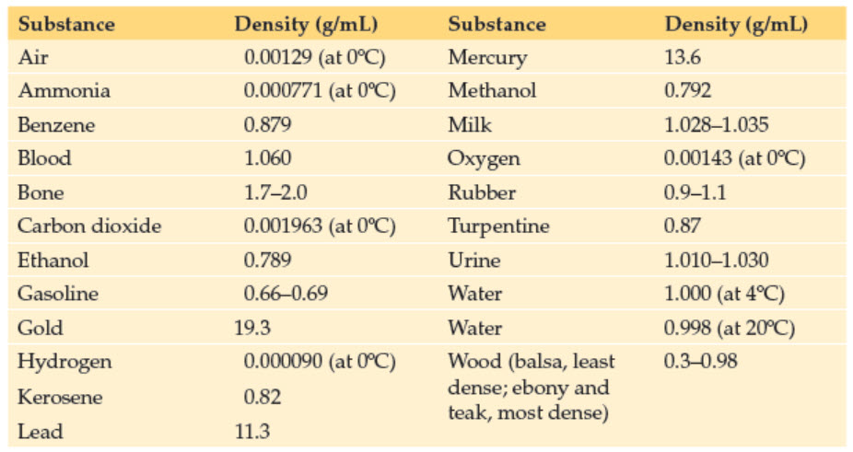
Densities of Some Common Materials
Copyright © 2017 McGraw-Hill Education. Permission required for reproduction or display

Slide 15
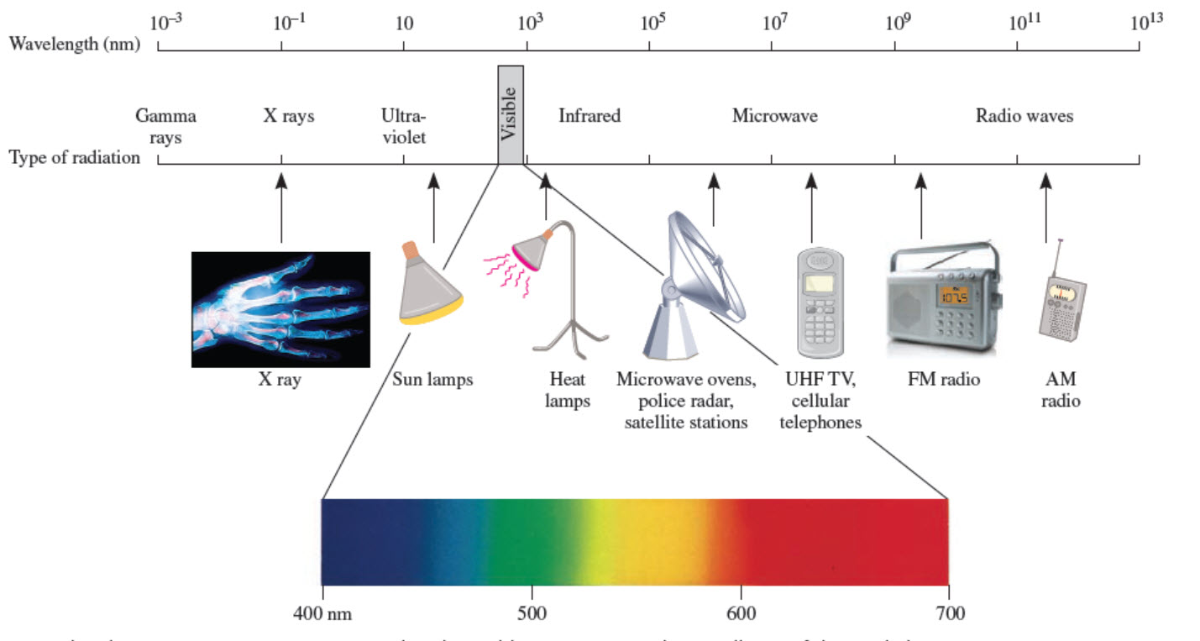
Electromagnetic Spectrum
high energy
short wavelength
low energy
long wavelength
Copyright © 2017 McGraw-Hill Education. Permission required for reproduction or display

Slide 16
2.3 Light, Atomic Structure, and the Bohr Atom
Rutherford’s atom
  Tiny, dense, positively charged nucleus of protons surrounded by electrons
How do we describe the relationship of the electrons to each other and the nucleus?
  Use the measurement of particle energy rather than position

Slide 17
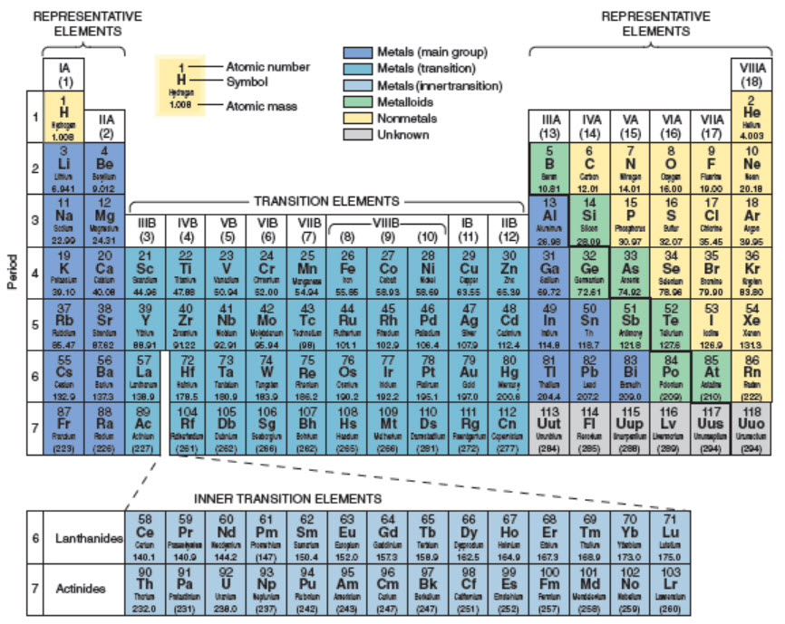
Classification of the Elements
2.4 The Periodic Law and the Periodic Table
Copyright © 2017 McGraw-Hill Education. Permission required for reproduction or display

Slide 18
The Octet Rule
Octet Rule - elements usually react in such a way as to attain the electron configuration of the noble gas closest to them in the periodic table
  Elements on the right side of the table move “forward” to the next noble gas
  Elements on the left side move “backward” to the noble gas of the previous row
Atoms will gain, lose or share electrons in chemical reactions to attain this more stable energy state
2.6 Valence Electrons and the Octet Rule

Slide 19
Ions
Ions - electrically charged particles that result from a gain or loss of one or more electrons by the parent atom
Cation - positively charged
  result from the loss of electrons
  Na → Na⁺ + 1e⁻
Anion - negatively charged
  results from the gain of electrons
  F + 1 e⁻ → F⁻
2.6 Valence Electrons and the Octet Rule
11

Slide 20
3.1 Chemical Bonding
Chemical bond - the force of attraction between any two atoms in a compound
This attractive force overcomes the repulsion of the positively charged nuclei of the two atoms participating in the bond
Interactions involving valence electrons are responsible for the chemical bond

Slide 21
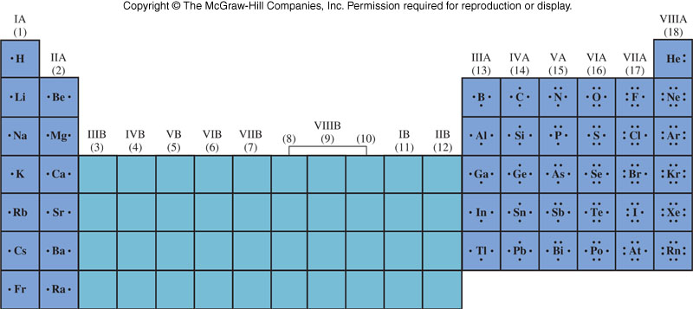
Lewis Symbols for Representative Elements
3.1 Chemical Bonding

Slide 22
Covalent Bond
Instead, each atom attains a noble gas configuration by sharing electrons
3.1 Chemical Bonding
Each hydrogen atom now has two electrons around it and attained a He configuration
The shared
electron
pair is called a
Covalent Bond

Slide 23
Examples of Covalent Bonding
2e– from 2H 2e– for H
6e– from O 8e– for O
3.1 Chemical Bonding
4e– from 4H 2e– for H
4e– from C 8e– for C

Slide 24
Polar Covalent Bond
somewhat positively charged
somewhat negatively charged
The electrons spend more time with fluorine
This sets up a polar covalent bond
A truly covalent bond can only occur when both atoms are identical
These two
electrons are
not shared equally

Slide 25
Electronegativity
Electronegativity - a measure of the ability of an atom to attract electrons in a chemical bond
Elements with high electronegativity have a greater ability to attract electrons than do elements with low electronegativity
Consider the covalent bond as competition for electrons between 2 positive centers
  The difference in electronegativity determines the extent of bond polarity
3.1 Chemical Bonding

Slide 26
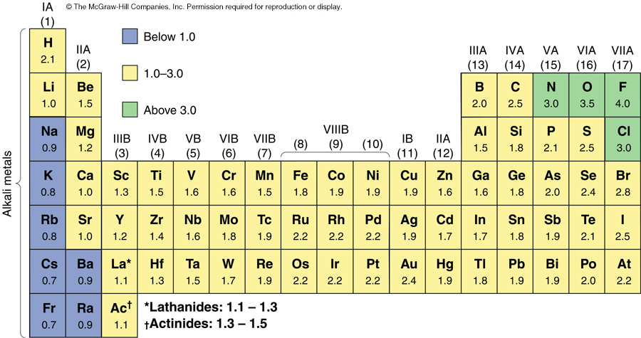
Electronegativities of Selected Elements
The most electronegative elements are found in the upper right corner of the periodic table
The least electronegative elements are found in the lower left corner of the periodic table
3.1 Chemical Bonding
electronegativity increases
electronegativity increases

Slide 27
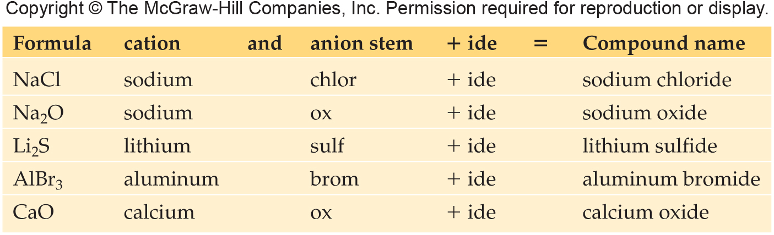
Writing Names of Ionic Compounds from the Formula of the Compound
Name the cation followed by the name of the anion
A positive ion retains the name of the element; change the anion suffix to -ide

Slide 28
Writing Formulas of Covalent Compounds
Use the prefixes in the names to determine the subscripts for the elements
Examples:
  nitrogen trichloride NCl₃
  diphosphorus pentoxide P₂O₅
Some common names that are used:
  H₂O water
  NH₃ ammonia
  C₂H₅OH ethanol or ethyl alcohol
  C₆H₁₂O₆ glucose
4
3.2 Naming Compounds and Writing Formulas of Compounds

Slide 29
Odd Electron
Odd electron - if there is an odd number of valence electrons, it is not possible to give every atom eight electrons
  Let’s look at NO, nitric oxide
  It is impossible to pair all electrons as the compound contains an ODD number of valence electrons
3.4 Drawing Lewis Structures of Molecules
N = O

Slide 30
Lewis Structures and Molecular Geometry; VSEPR Theory
8
Molecular shape plays a large part in determining properties and shape
VSEPR theory - Valance Shell Electron Pair Repulsion theory
  Used to predict the shape of the molecules
  All electrons around the central atom arrange themselves so they can be as far away from each other as possible – to minimize electronic repulsion.
3.4 Drawing Lewis Structures of Molecules

Slide 31
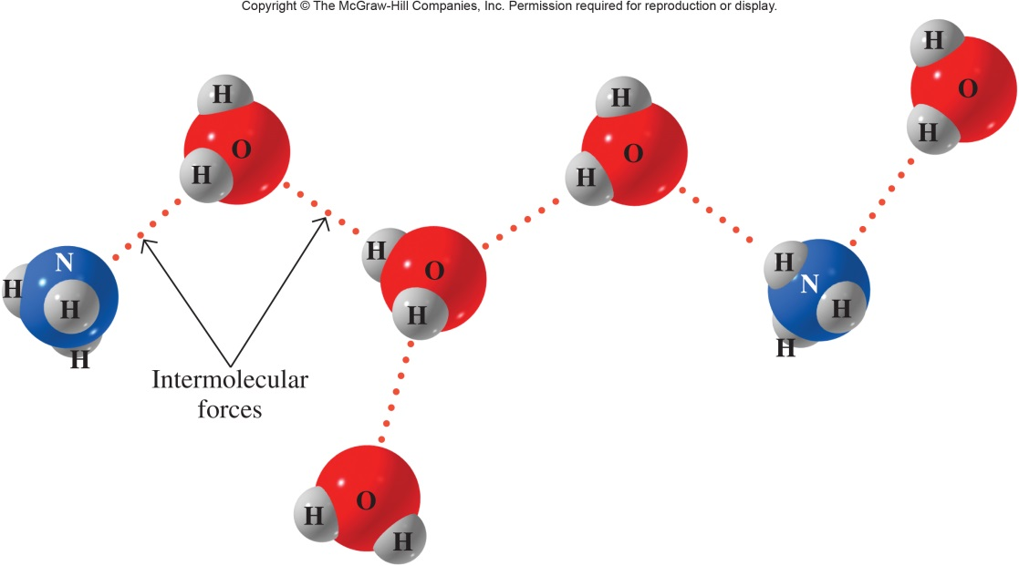
Interaction of Water and Ammonia
3.5 Properties Based on Molecular Geometry & Intermolecular Forces
The δ⁻ end of ammonia, N, is attracted to the δ⁺ end of the water molecule, H
The δ⁺ end of ammonia, H, is attracted to the δ⁻ end of the water molecule, O

Slide 32
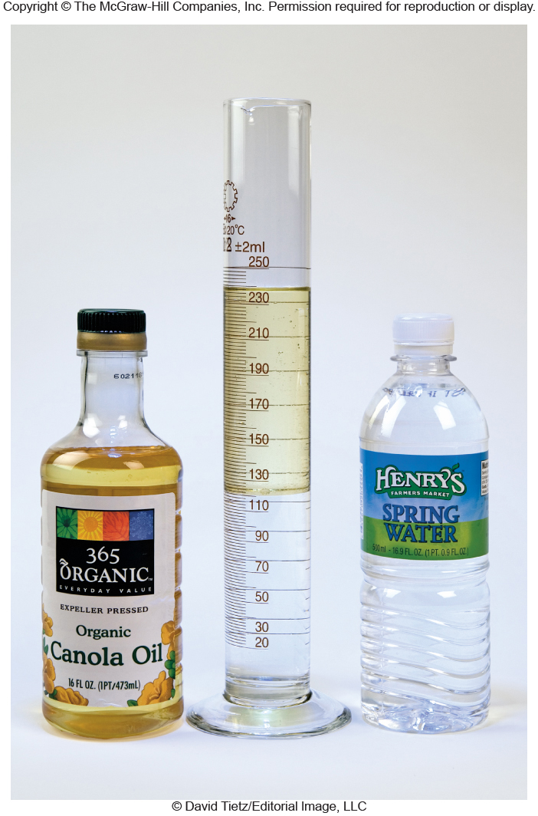
Interaction of Water and Oil
What do you know about oil and water?
  “They don’t mix”
Why?
  Because water is polar and oil is nonpolar
3.5 Properties Based on Molecular Geometry & Intermolecular Forces

Slide 33
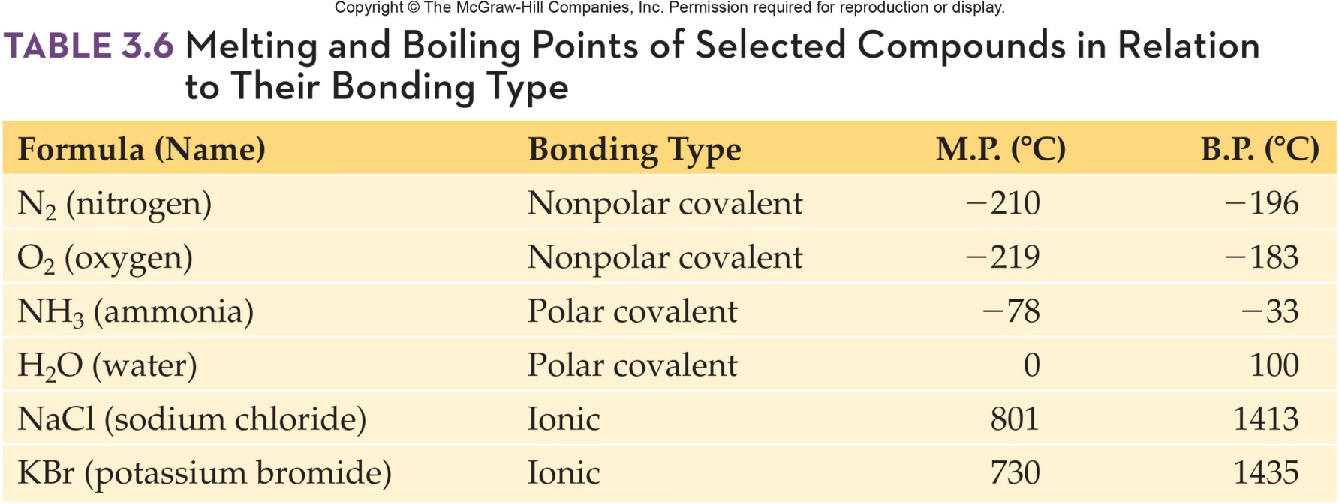
Melting and Boiling Points Selected Compounds by Bonding Type

Slide 34
Balancing
7
Coefficient - how many of that substance are in the reaction
4.4 Balancing Chemical
Equations
The equation must be balanced
  All the atoms of every reactant must also appear in the products
Number of Hg on left? 2
  on right 2
Number of O on left? 2
  on right 2

Slide 35
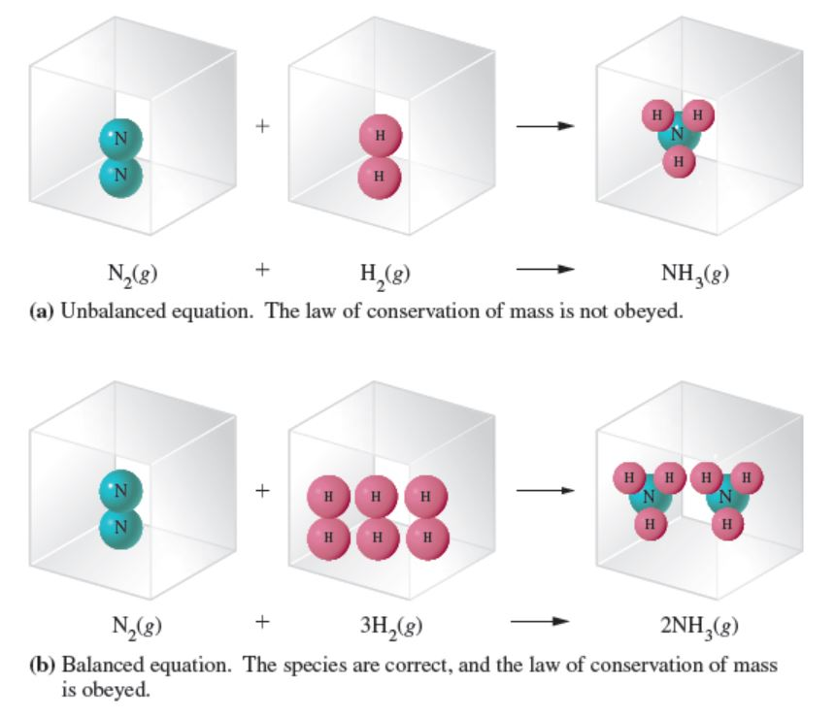
Balancing an Equation
4.4 Balancing Chemical
Equations
Copyright © 2017 McGraw-Hill Education. Permission required for reproduction or display

Slide 36
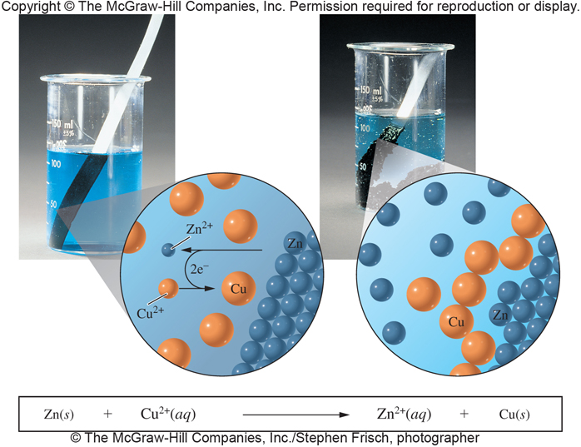
Voltaic Cell Generating Electrical Current
4.8 Oxidation-Reduction Reactions
Cu²⁺ + 2e⁻ → Cu
Reduction
cathode – electrode where reduction occurs
Zn → Zn²⁺ + 2e⁻
Oxidation
anode – electrode
where oxidation occurs

Slide 37
Molarity
8
The most common mole-based concentration unit is molarity
Molarity
  Symbolized M
  Defined as the number of moles of solute per liter of solution
6.3 Concentration Based on Moles

Slide 38
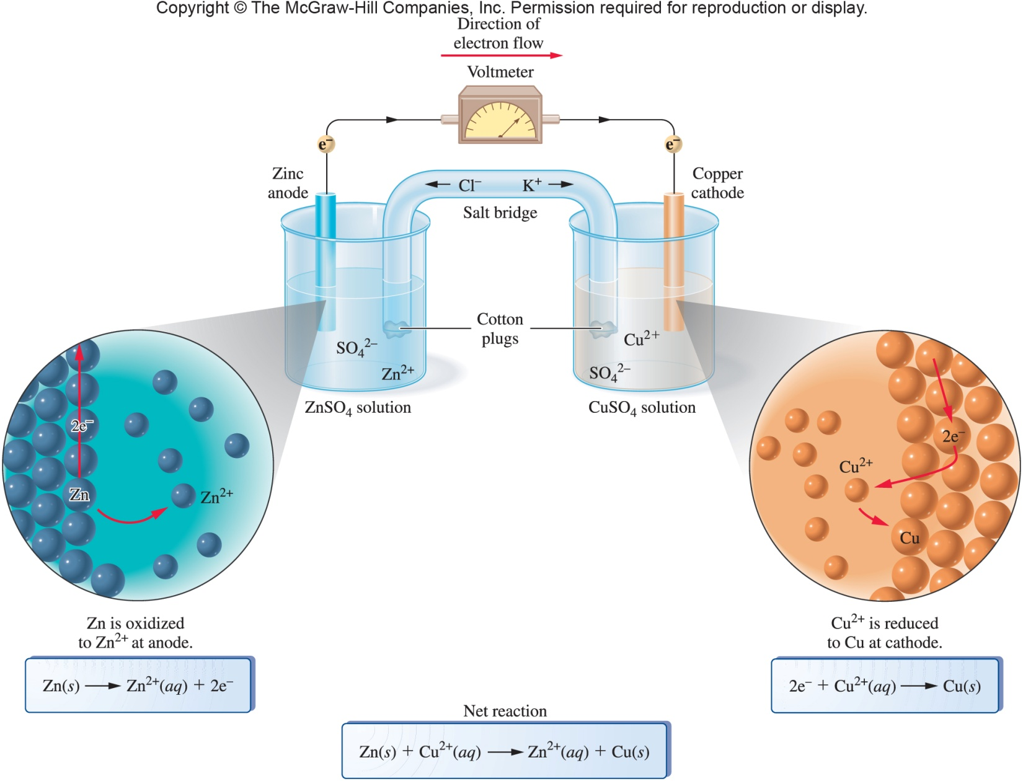
Voltaic Cell Representation
4.8 Oxidation-Reduction Reactions

Slide 39
Freezing Point Depression and Boiling Point Elevation
Freezing point depression may be explained considering the equilibrium between solid and liquid states
  Solute molecules interfere with the rate at which liquid water molecules associate to form the solid state
Boiling point elevation can be explained considering the definition as the temperature at which vapor pressure of the liquid equals the atmospheric pressure
  If a solute is present, then the increase in boiling temperature is necessary to raise the vapor pressure to atmospheric temperature
6.4 Concentration-Dependent Solution Properties

Slide 40
Freezing Point Depression
Freezing point depression (ΔT_{f}) - is proportional to the number of solute particles
How does an electrolyte behave?
  Dissociates into ions
  NaCl forms two ions (two particles)
An equal concentration of NaCl will affect the freezing point twice as much as glucose (a nonelectrolyte)
Each solvent has a unique freezing point depression constant or proportionality factor (k_{f})
11
6.4 Concentration-Dependent Solution Properties
ΔT_{f} = k_{f} m

Slide 41
Boiling Point Elevation
Boiling point elevation (ΔT_{b}) - is proportional to the number of solute particles
An electrolyte will affect boiling point to a greater degree than a nonelectrolyte of the same concentration
Each solvent has a unique boiling point elevation constant (k_{b})
11
6.4 Concentration-Dependent Solution Properties
ΔT_{b} = k_{b} m

Slide 42
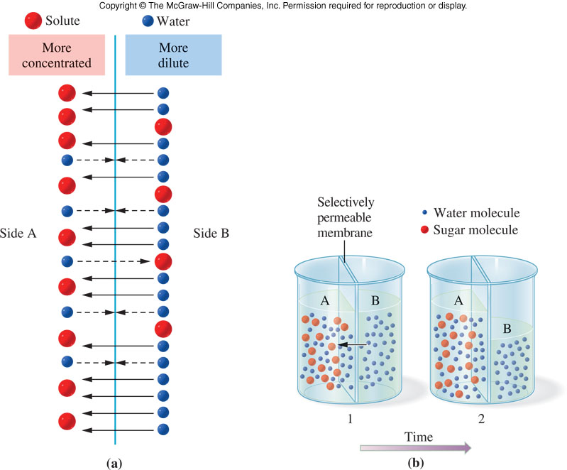
Osmosis
Osmosis - the movement of solvent from a dilute solution to a more concentrated solution through a semipermeable membrane
Requires pressure to stop this flow
6.4 Concentration-Dependent Solution Properties

Slide 43
Osmotic Pressure and Osmolarity
11
Osmolarity - the molarity of particles in solution
  Osmolarity = i x M
    i = number of mol particles/mol solute
    M = molar concentration of solute
Osmotic pressure (π) - the amount of pressure required to stop the flow across a semipermeable membrane
    R = ideal gas constant
    T = solution temperature (K)
6.4 Concentration-Dependent Solution Properties
π=iMRT

Slide 44
Red Blood Cells
Living cells contain aqueous solution and these cells are also surrounded by aqueous solution
  Cell function requires maintenance of the same osmotic pressure inside and outside the cell
Isotonic solutions have identical osmotic pressures and no osmotic pressure difference across the cell membrane
  Solute concentration of fluid surrounding cells higher than inside results in a hypertonic solution causing water to flow into the surroundings, causing collapse
  Solute concentration of fluid surrounding cells too low, results in a hypotonic solution causing water to flow into the cell, causing rupture
6.4 Concentration-Dependent Solution Properties

Slide 45
6.5 Aqueous Solutions
12
Water is often referred to as the “universal solvent”
  Excellent solvent for polar molecules
Most abundant liquid on earth
60% of the human body is water
  Transports ions, nutrients, and waste into and out of cells
  Solvent for biochemical reactions in cells and digestive tract
  Reactant or product in some biochemical processes

Slide 46
Active Transport
14
Active transport – used in transporting Na⁺ and K⁺ ions across the cell membrane
Cellular energy must be expended to make concentration of ions different on each side of the cell membrane
This is accomplished via large protein molecules embedded in cell membranes
6.5 Aqueous Solution

Slide 47
Biological Effects of Electrolytes in Solution (Na⁺ and K⁺)
Danger to the body occurs when Na⁺ and K⁺ both in blood and in cells becomes too high or low
6.5 Aqueous Solution
  Na⁺ too low:
    Decrease of urine output
    Dry mouth
    Flushed skin
    Fever
  Na⁺ too high:
    Confusion, stupor, or coma
K⁺ too high:
  Death by heart failure
K⁺ too low:
  Death by heart failure

Slide 48
Biological Effects of Electrolytes in Solution (Cl⁻ and HCO₃⁻)
The two most important anions in the body fluids are Cl⁻ and HCO₃⁻
Cl⁻
  acid/base balance
  maintenance of osmotic pressure
  oxygen transport by hemoglobin
6.5 Aqueous Solution
HCO₃⁻
  form in which most waste CO₂ is removed from the body

Slide 49
Blood Composition and Role
A variety of proteins are also found as a colloidal dispersion in the blood
  Include:
    Blood clotting factors
    Antibodies
    Albumins
      Carrier of substances that cannot dissolve in water
Blood also transports nutrients and waste products
6.5 Aqueous Solution

Slide 50
System vs. Surroundings
Absolute value for energy stored in a chemical system cannot be measured
Can measure the change in energy during these chemical changes
System – contains the process under study
Surroundings – the rest of the universe
7.1 Thermodynamics

Slide 51
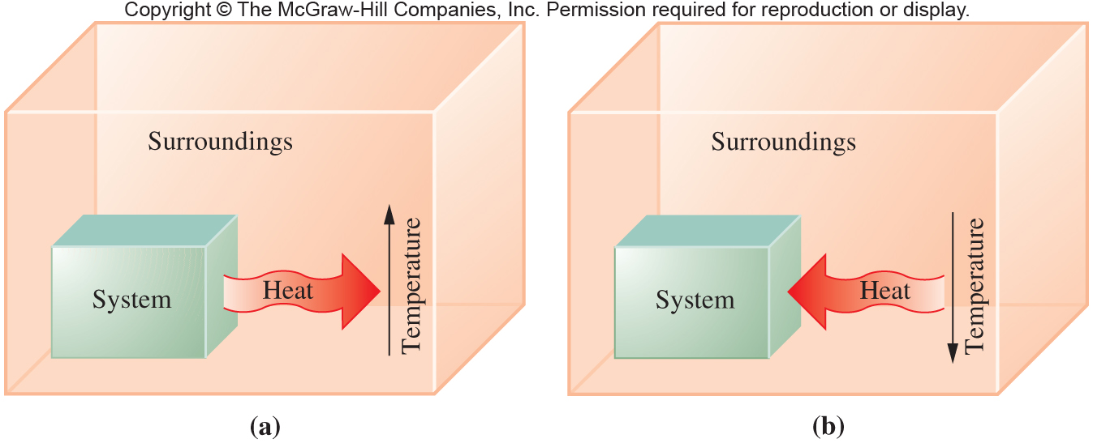
The Chemical Reaction and Energy
Energy can be lost from the system to the surroundings
Energy may be gained by the system at the expense of the surroundings
  This energy change is usually in the form of heat
  This change can be measured
7.1 Thermodynamics

Slide 52
The First Law of Thermodynamics
First Law of Thermodynamics – energy of the universe is constant
This law is also called the Law of Conservation of Energy
Where does the reaction energy come from that is released and where does the energy go when it is absorbed?
7.1 Thermodynamics

Slide 53
Enthalpy
Enthalpy – represents heat energy
Change in Enthalpy (ΔH) – energy difference between the products and reactants of a chemical reaction
The ΔH over the course of a reaction can be determined by:
ΔH_{reaction} = ΔH_{products} − ΔH_{reactants}
2
7.1 Thermodynamics

Slide 54
The Second Law of Thermodynamics
2
Second Law of Thermodynamics – the universe spontaneously tends toward increasing disorder or randomness
Entropy (S) – a measure of the randomness of a chemical system
  High entropy – highly disordered system, the absence of a regular, repeating pattern
  Low entropy – well organized system such as a crystalline structure
  No such thing as negative entropy
7.1 Thermodynamics

Slide 55
The Second Law of Thermodynamics
Representation
Phase change
Melting
Vaporization
Dissolution
7.1 Thermodynamics
All of these processes have a positive ΔS

Slide 56
Free Energy and Spontaneity
2
Free energy (ΔG) – represents the combined contribution of the enthalpy and entropy values for a chemical reaction
Free energy predicts spontaneity of chemical reactions
  Negative ΔG, always Spontaneous
  Positive ΔG, never Spontaneous
7.1 Thermodynamics
ΔG = ΔH - TΔS
T in Kelvin

Slide 57
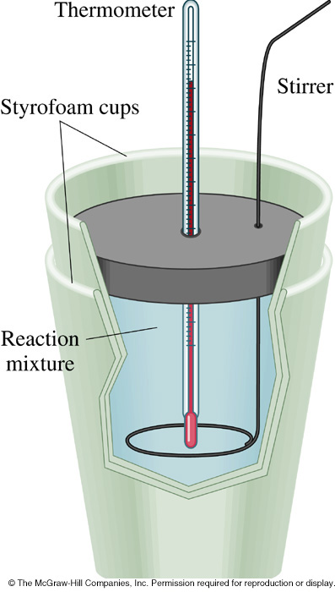
7.2 Experimental Determination of Energy Change in Reactions
3
Calorimetry – the measurement of heat energy changes in a reaction
Calorimeter – device which measures heat changes in calories
The change in temperature is used to measure the loss or gain of heat

Slide 58
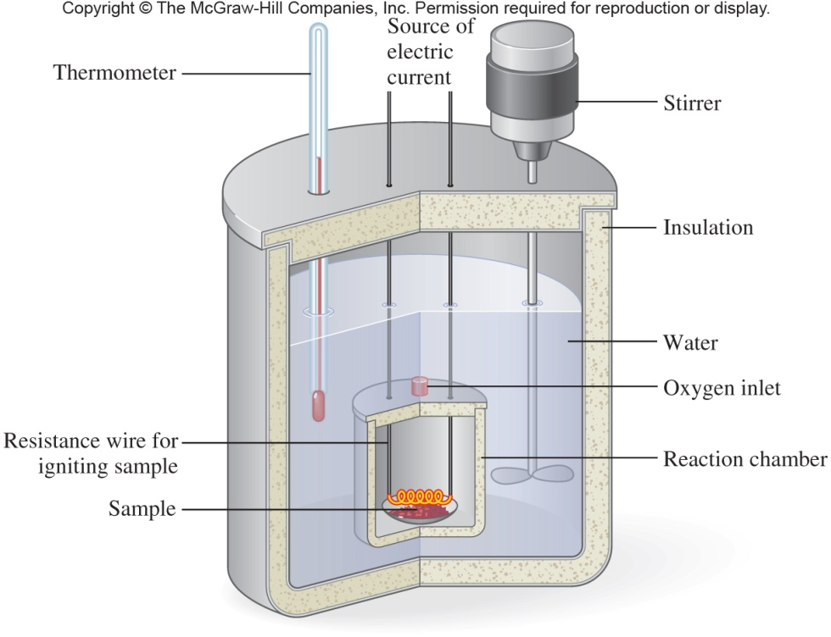
Bomb Calorimeter and Measurement of Calories in Foods
3
nutritional Calorie (large “C” Calorie) =
  1 kilocalorie (1kcal)
  1000 calories
7.2 Determination of Energy Change in Reactions
  Fuel value of food
  Bomb calorimeter is used to measure Cal

Slide 59
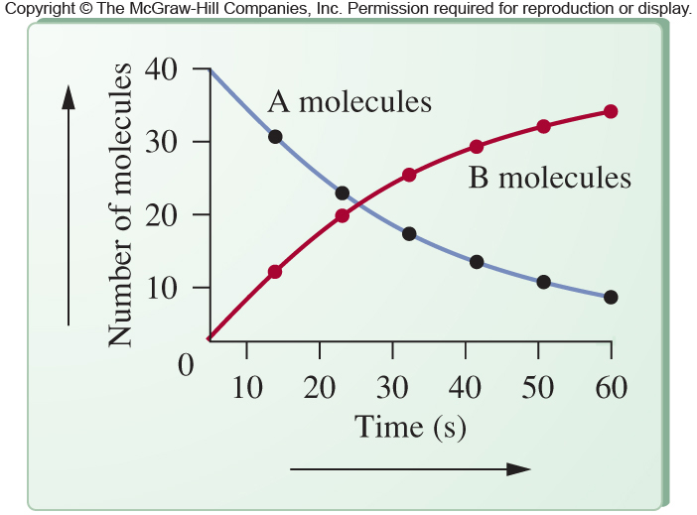
Kinetic Information
Kinetic information represents changes over time, seen here:
  disappearance of reactant, A
  appearance of product, B
7.3 Kinetics

Slide 60
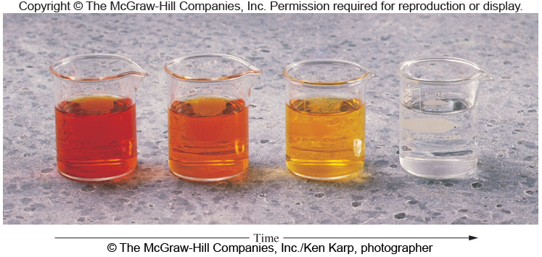
Kinetic Data Assessed by Color Change
Change in color over time can be used to monitor the progress of a chemical reaction
The rate of color change can aid in calculating the rate of the chemical reaction
7.3 Kinetics

Slide 61
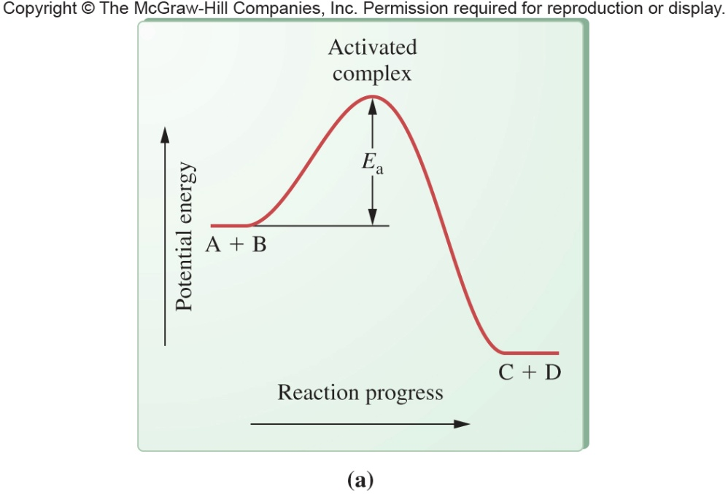
Model of Activation Energy and the Activated Complex
5
Reaction proceeds from reactants to products via the activated complex
Activated complex – can’t be isolated from the reaction mixture
Activation energy (E_{a}) - the difference between the energy of the reactants and that of the activated complex
7.3 Kinetics
To be an Exothermic reaction requires a net release of energy (ΔH)

Slide 62
Factors That Affect Reaction Rate
6
Structure of the reacting species
Molecular shape and orientation
Concentration of reactants
Temperature of reactants
Physical state of reactants
Presence of a catalyst
7.3 Kinetics

Slide 63
Equilibrium Reactions
Chemical equilibrium – state of a reaction in which the rates for the forward and reverse reactions are equal
Equilibrium reactions – chemical reactions that do not go to completion
  Completion: all reactants have been converted to products
  Also called incomplete reactions
After no further observable change, measurable quantities of reactants and products remain
7.4 Equilibrium

Slide 64
LeChatelier’s Principle
LeChatelier’s Principle – if a stress is placed on a system at equilibrium, the system will respond by altering the equilibrium composition in such a way as to minimize the stress
If reactants and products are present in a fixed volume and more NH₃ is added into the container, the system will be stressed
  Stressed = the equilibrium will be disturbed
10
7.4 Equilibrium
N₂(g) + 3H₂(g) 2NH₃(g)

Slide 65
Effect of a Catalyst
A catalyst has no effect on the equilibrium composition
It increases the rate of both the forward and reverse reaction to the same extent
While equilibrium composition and concentration do not change, equilibrium is reached in a shorter time
7.4 Equilibrium

Slide 66
Brønsted-Lowry Theory of Acids and Bases
Acid – proton (H⁺) donor
Base - proton (H⁺) acceptor
  Notice that acid and base are not defined using water
  When writing the reactions, both accepting and donating are evident
8.1 Acids and Bases

Slide 67
8.3 Reactions Between
Acids and Bases
8
Neutralization reaction – the reaction of an acid with a base to produce a salt and water
HCl(aq) + NaOH(aq) → NaCl(aq) + H₂O(l)
Acid Base Salt Water
Break apart into ions:
H⁺(aq) + Cl⁻(aq) + Na⁺(aq) + OH⁻(aq) →
Na⁺(aq) + Cl⁻(aq) + H₂O(l)
Net ionic equation
  Show only the changed components
  Omit any ions appearing the same on both sides of equation (Spectator Ions)
H⁺(aq) + OH⁻(aq) → H₂O(l)

Slide 68
Acid-Base Properties of Water
2
Water possesses both acid and base properties
  Amphiprotic – a substance possessing both acid and base properties
  Water is the most commonly used solvent for both acids and bases
  Solute-solvent interactions between water and both acids and bases promote solubility and dissociation
8.1 Acids and Bases

Slide 69
Self-ionization of Water
5
Pure water is virtually 100% molecular
Very small number of molecules dissociate
  Dissociation of acids and bases is often called ionization
Dissociation of water is self-ionization
Very weak electrolyte
8.1 Acids and Bases
H₂O(l) + H₂O(l) H₃O⁺(aq) + OH⁻(aq)

Slide 70
Hydronium Ion
H₃O⁺ is called the hydronium ion
In pure water at room temperature:
  [H₃O⁺] = 1 × 10⁻⁷ M
  [OH⁻] = 1 × 10⁻⁷ M
What is the equilibrium expression for:
Remember, liquids are not included in equilibrium expressions
8.1 Acids and Bases
H₂O(l) + H₂O(l) H₃O⁺(aq) + OH⁻(aq)
K_{eq} = [H₃O⁺][OH⁻]

Slide 71
8.2 pH: A Measurement Scale for Acids and Bases
6
pH scale – a scale that indicates the acidity or basicity of a solution
  Ranges from 0 (very acidic) to 14 (very basic)
The pH scale is rather similar to the temperature scale assigning relative values of hot and cold
The pH of a solution is defined as:
pH = −log[H₃O⁺]

Slide 72
The Importance of pH and pH Control
Any change that takes place in aqueous solution generally has at least some pH dependence
  Agriculture – crops grow best in soil with proper pH
  Physiology – blood pH shift of 1 pH is fatal
  Acid Rain – lowers pH of water in aquatic systems causing problems for native fishes
  Municipal services – sewage treatment and water purification require optimal pH
  Industry – many processes require strict pH control for cost-effective production
8.2 pH: A Measurement Scale for Acids and Bases

Slide 73
8.4 Acid-Base Buffers
The Buffer Process
Buffers act to establish an equilibrium between a conjugate acid/base pair
Buffers consist of either
  a weak acid and its salt (conjugate base)
  a weak base and its salt (conjugate acid)
An example is acetic acid, CH₃COOH, and its conjugate base CH₃COO⁻
An equilibrium is established in solution between the acid and the salt anion
A buffer is LeChatelier’s Principle in action
CH₃COOH(aq) + H₂O(l) CH₃COO⁻(aq) + H₃O⁺(aq)

Slide 74
9.1 Natural Radioactivity
Radioactivity – process by which atoms emit energetic particles or rays
Radiation – the particles or rays emitted
  comes from the nucleus
Nuclear symbols – what we use to designate the nucleus
  Atomic symbol
  Atomic number
  Mass number

Slide 75
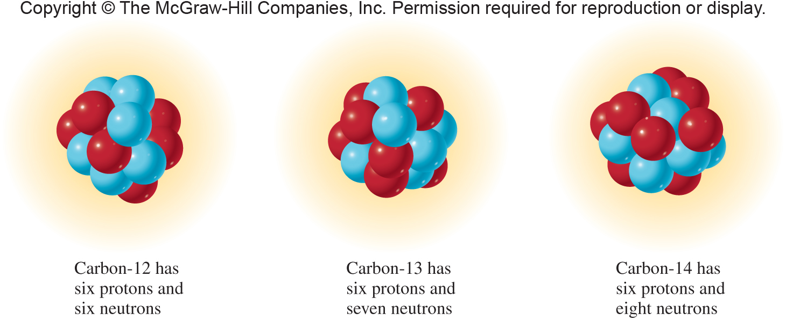
Three Isotopes of Carbon
Each nucleus contains the same number of protons
Only the number of neutrons is different
With different numbers of neutrons the mass of each isotope is different
9.1 Natural Radioactivity
¹²C
¹³C
¹⁴C
⁶
⁶
⁶

Slide 76
Unstable Isotopes
Some isotopes are stable
The unstable isotopes are the ones that produce radioactivity
To write nuclear equations we need to be able to write the symbols for the isotopes and the following:
  alpha particles
  beta particles
  positrons
  gamma rays
9.1 Natural Radioactivity

Slide 77
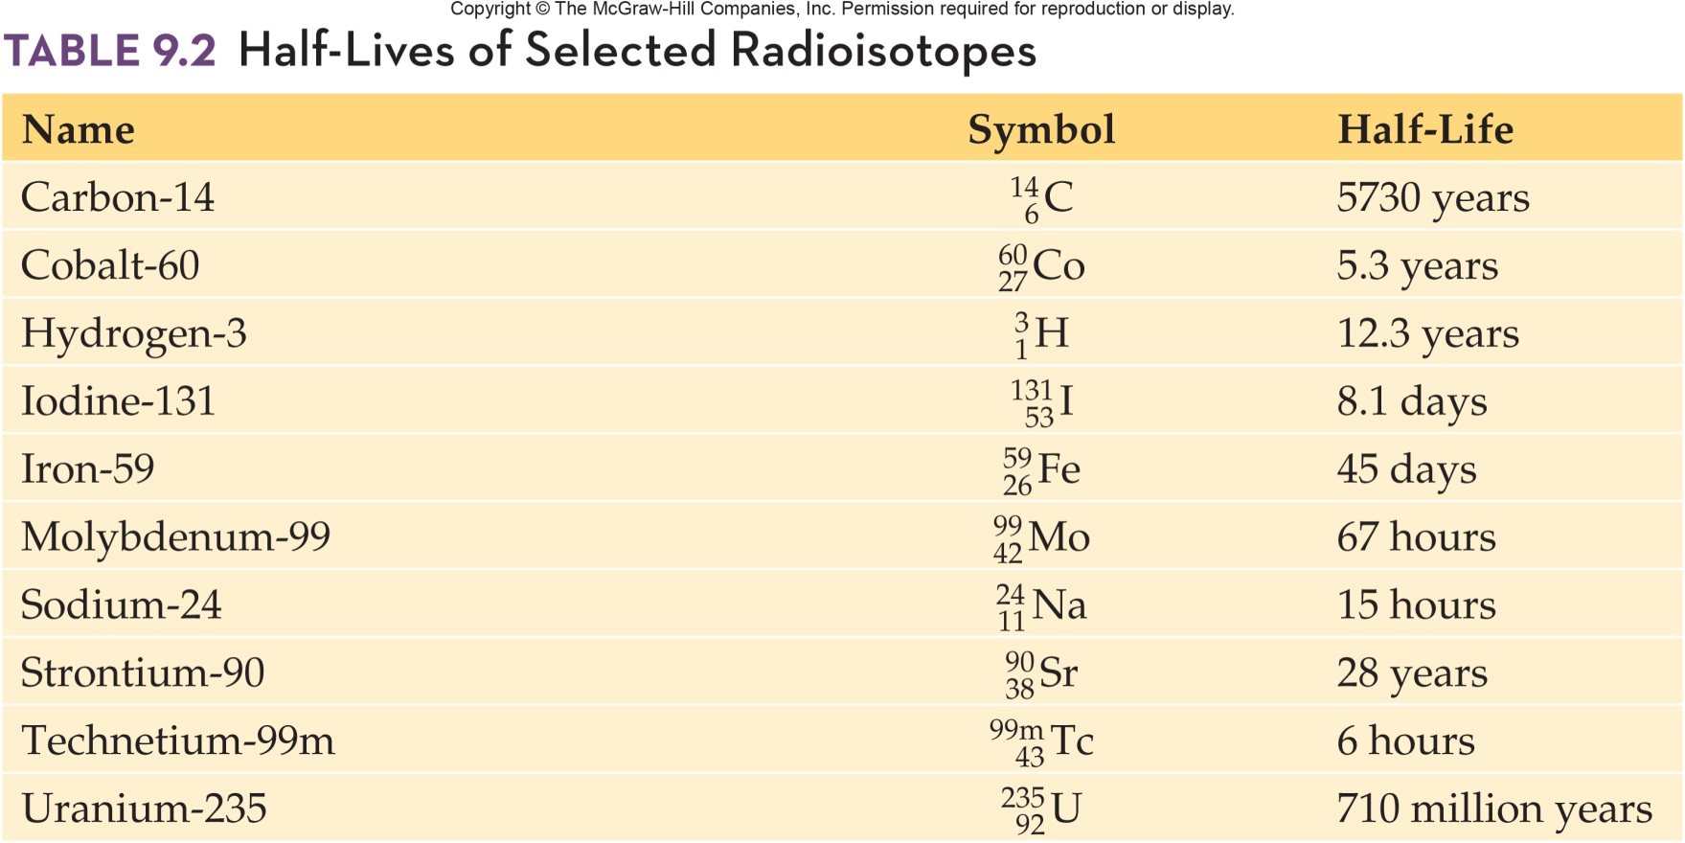
Half-Lives of Selected Radioisotopes
9.3 Properties of Radioisotopes

Slide 78
9.5 Radiocarbon Dating
Radiocarbon Dating Limitations
The half-life of carbon-14 is 5730 years
The carbon-12 does not decay; it is the stable isotope
The ratio of carbon-12 to carbon-14 enables us to calculate the age of an artifact
This dating technique is limited to objects less than 50,000 years old (9 half-lives)

Slide 79
9.5 Medical Applications of Radioactivity
Cancer Therapy Using Radiation
8
Based on the fact that high-energy gamma rays cause damage to biological molecules
Tumor cells are more susceptible than normal cells
Example: cobalt-60
Gamma radiation can cure cancer but can also cause cancer

Slide 80
